Slide 1

Presentation Of Projects Report An Android-based Gaming Initiative: Plane Warrior
In the partial fulfillment of the award of DIPLOMA OF ENGINEERING
IN
COMPUTER SCIENCE & ENGINEERING
Presented By:-
SUSHIL KUMAR DCS-CDE/2010238
SIDDHANT KUMAR DCS-CDE/2010229
Under the Guidance of:-
Dr. Jaspal Singh
Assistance Professor
(CSE Department)
Sant Longowal Institute of Engineering & Technology, Longowal – 148106
District – Sangrur, Punjab
May 2023

Slide 2
Contents
Introduction.
Objectives.
Technology and specific tool to be used.
Hardware and Software requirements.
Future Scope
References

Slide 3
Introduction
Floppy Plane is an engaging 2D game designed to provide an addictive and
entertaining experience for players. Inspired by the popular "Flappy Bird" concept,
Floppy Plane introduces its unique twists and challenges. The game offers
simple mechanics, colorful visuals, and a high level of replayability.
Incorporating coins as a game mechanic can be a great way to make the game more
Interesting and challenging for the players. Collecting Points can be a goal for the player,
as it can unlock new abilities, power-ups, or upgrades.

Slide 4
Objectives
The Key Point Objective of a Floppy Plane Game (2D)
Survive and Stay Airborne: The primary objective of Floppy Plane is to keep the paper airplane airborne for as long as possible. Players must navigate through a series of obstacles without colliding with them. The longer the plane stays in the air, the higher the score and the greater the accomplishment.
Avoid Obstacles: The game presents various obstacles, such as pipes, walls, or moving objects, that the player must maneuver the floppy plane around. The objective is to demonstrate precise control and timing to avoid collisions. Successfully passing through narrow gaps and avoiding obstacles contribute to the player's score and progress.

Slide 5
Technology and specific tool to be used
c
U
vs
P
C# (sharp)
Unity
Photoshop
Visual Studio
C# (C-Sharp) is a programming language developed by Microsoft that runs on the .NET Framework.
Unity is a cross-platform game engine developed by Unity Technologies
Visual Studio Code is a code editor redefined and optimized for building and debugging modern web and cloud applications.
Adobe Photoshop is a raster graphics editor developed and published by Adobe Inc. for Windows and macOS. It was created in 1987 by Thomas

Slide 6
References
Unity Documentation
01
Unity documentation is a comprehensive reference guide for Unity, a popular game development platform.
Link:- https://docs.unity3d.com/Manual/index.
YouTube
02
YouTube has emerged as one of the best ways for game developers to share how their games are made. And more importantly, how you can make them too.
Google
https://www.youtube.com/
03
Develop Android games and deploy them to multiple device types on Android, Chrome OS, and Windows by using the Android Game Development Kit and Google Play

Slide 7
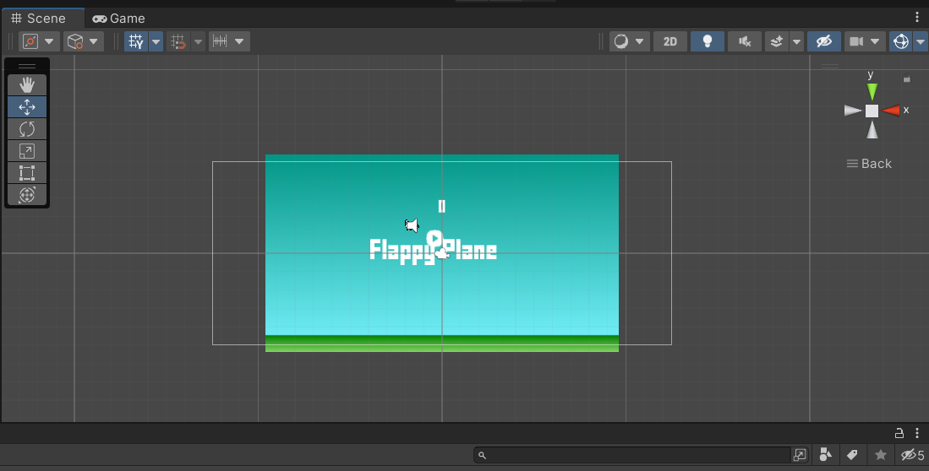
References
Aircraft
Game Background
UI

Slide 8
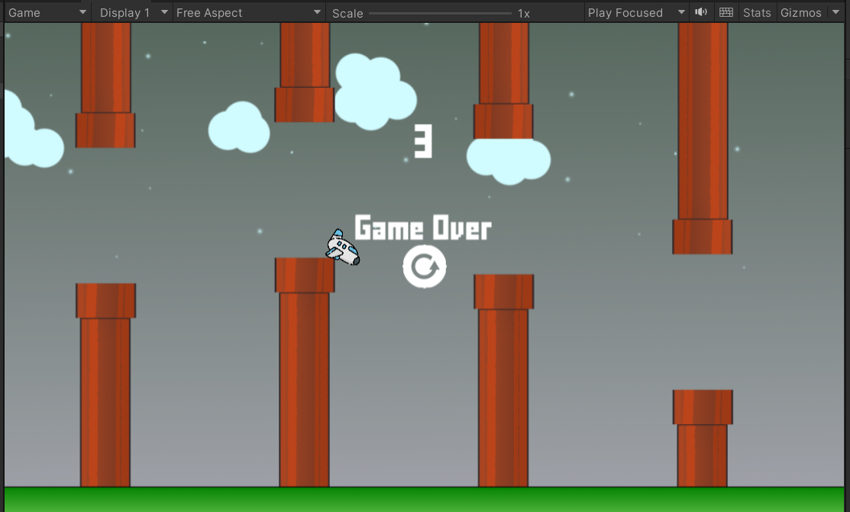
Some Images Are

Slide 9
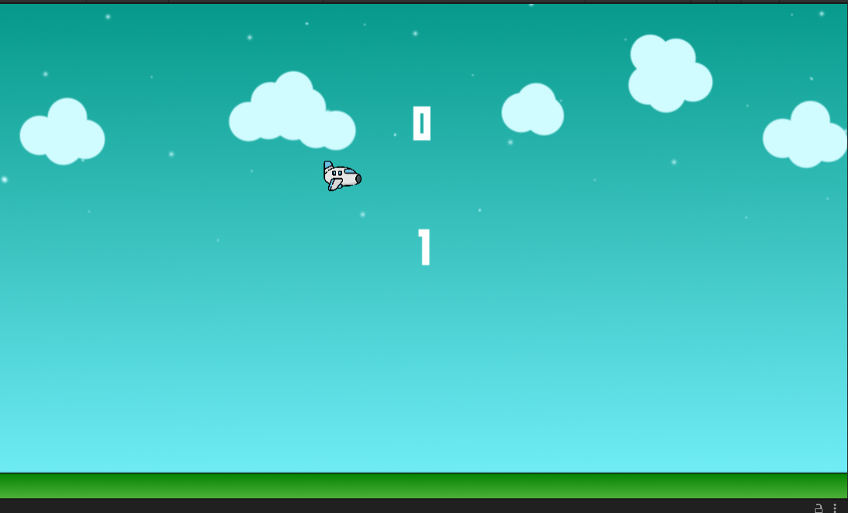

Slide 10
Future Scope
Floppy Plane 2D game, also known as Flappy Bird, gained significant popularity in the past. While the game itself might not be as trendy as it once was, there is still potential for innovation and exploration in the 2D game space. Here are a few future scope ideas for a floppy plane 2D game:-
Level Upgrade
Online MultiPlayer
Ofline Multiplayer
Global Leader Board

Slide 11
Thank You

